Slide 2
New Language Understanding (LUIS) Capabilities & Best Practices
Riham Mansour
Ahmed Ashour
BRK3208

Slide 3
Agenda
Overview of Conversational AI @ Microsoft
Customers’ case studies
Adding NL to bots using LUIS
What is new in LUIS for BUILD
LUIS best practices

Slide 4












Conversational AI: Azure Bot Service + Cognitive Services
User Input
Channels
Bot Intelligence
Business Process
Start
LOB Apps
Bing Search
Transition 1
Transition 2
Text
State 1
State 2
Transition 3
Speech
Transition 4
State 3
Bot Framework SDK Dialog manager
On premise
Speech
IFTTT
Enterprise stores
QnA Maker
Dispatch
Image
Translator
Language understanding
Azure Tools
Security
Logging
Auditing
Integration

Slide 5

Conversational AI: Azure Bot Service + Cognitive Services
User Input
Channels
Bot Intelligence
Bot Intelligence
Business Process
LOB Apps
Microsoft Azure
Text
On premise
Speech
IFTTT
Language understanding
Enterprise stores
Dispatch
Image
Azure Tools
Security
Logging
Auditing
Integration

Slide 6
Conversational AI: Azure Bot Service + Cognitive Services
User Input
Channels
Bot Intelligence
Business Process
Key Differentiators
Start
LOB Apps
Bing Search
Transition 2
Microsoft Azure
Full Bot Lifecycle, integrated with Azure
Code-first approach, CLI tools & GUI (tight AI integration)
Enterprise Grade SLA, Compliance and support for all services
LUIS offers the power of customization with little effort
Multi-lingual bots through advanced MT techniques
Transition 1
Text
State 1
State 2
Transition 3
Speech
Transition 4
State 3
Bot Framework SDK Dialog manager
On premise
Speech
IFTTT
Enterprise stores
QnA Maker
Dispatch
Image
Translator
Language understanding
Azure Tools
Security
Logging
Auditing
Integration

Slide 7
Key Differentiators
Full Bot Lifecycle, integrated with Azure
Code-first approach, CLI tools & GUI (tight AI integration)
Enterprise Grade SLA, Compliance and support for all services
LUIS offers the power of customization with little effort
Multi-lingual bots through advanced MT techniques

Slide 8
Customers’ Case Studies

Slide 9























Conversational AI: 1000+ Companies
More details: https://customers.microsoft.com

Slide 10
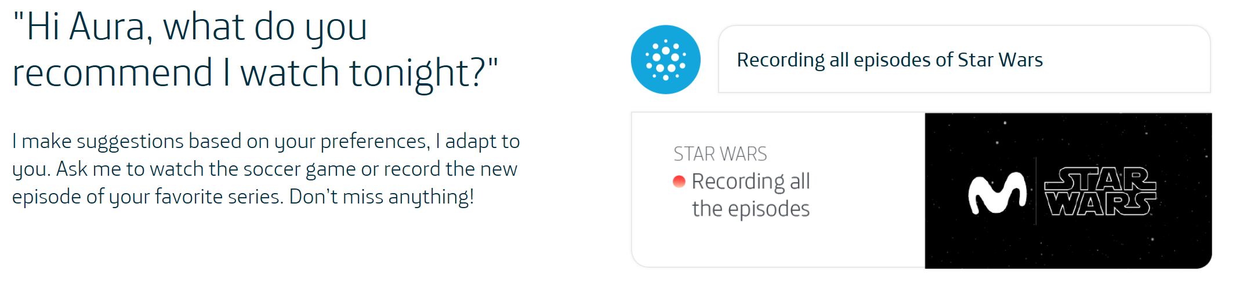
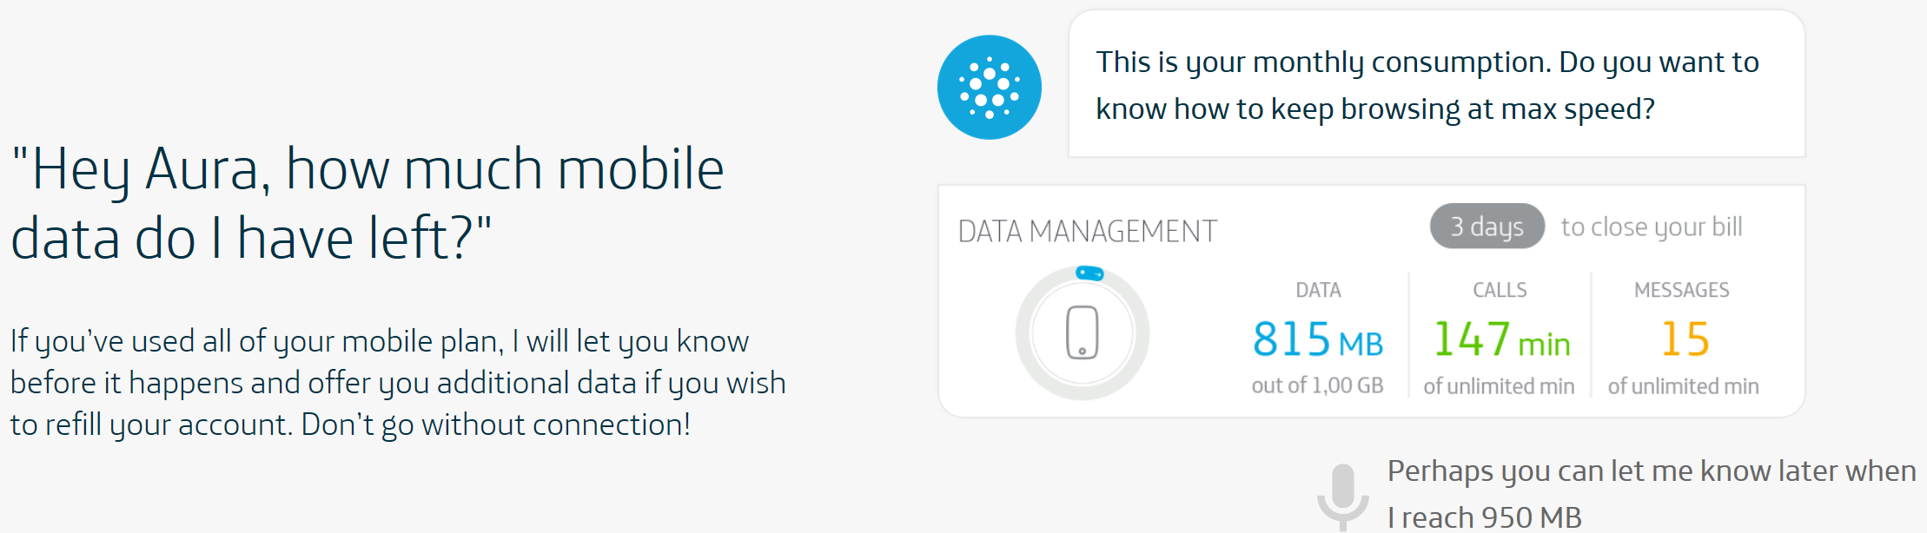
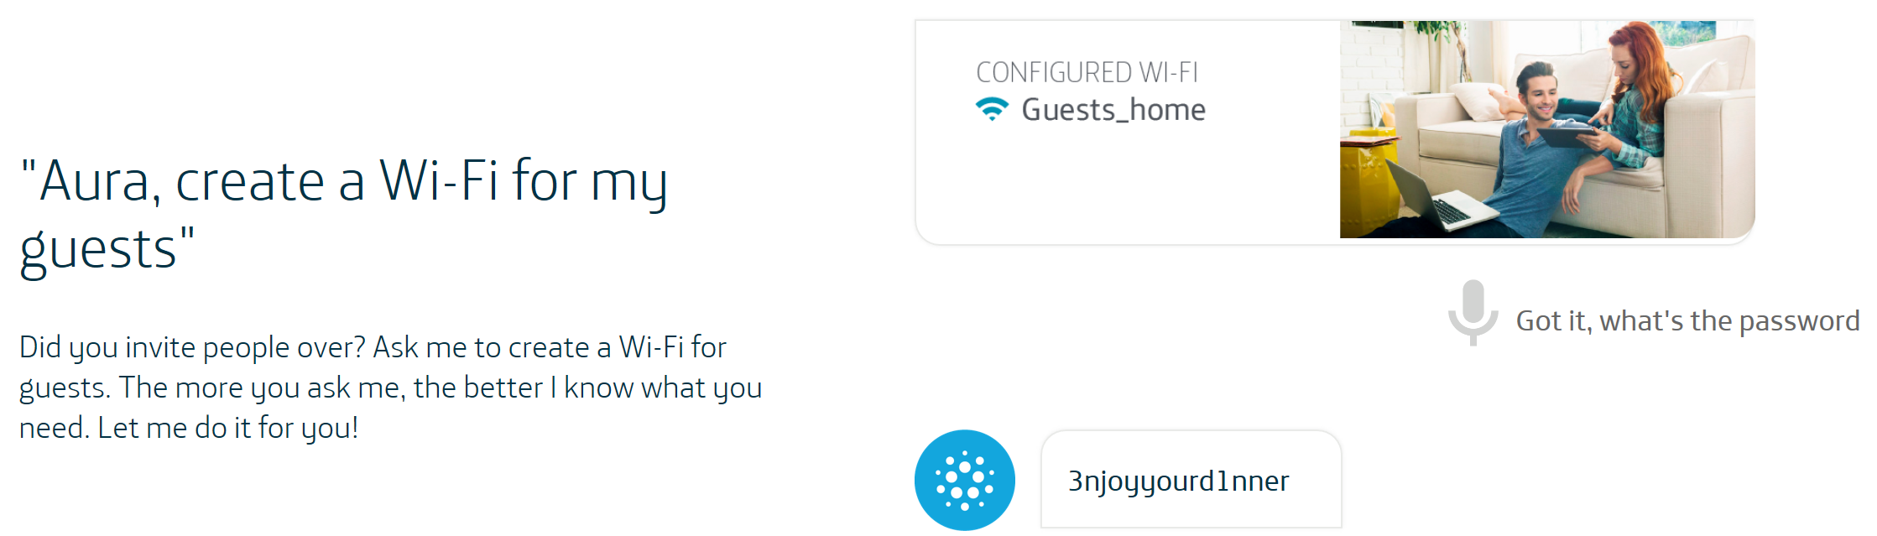
Telefonica AURA

Slide 11
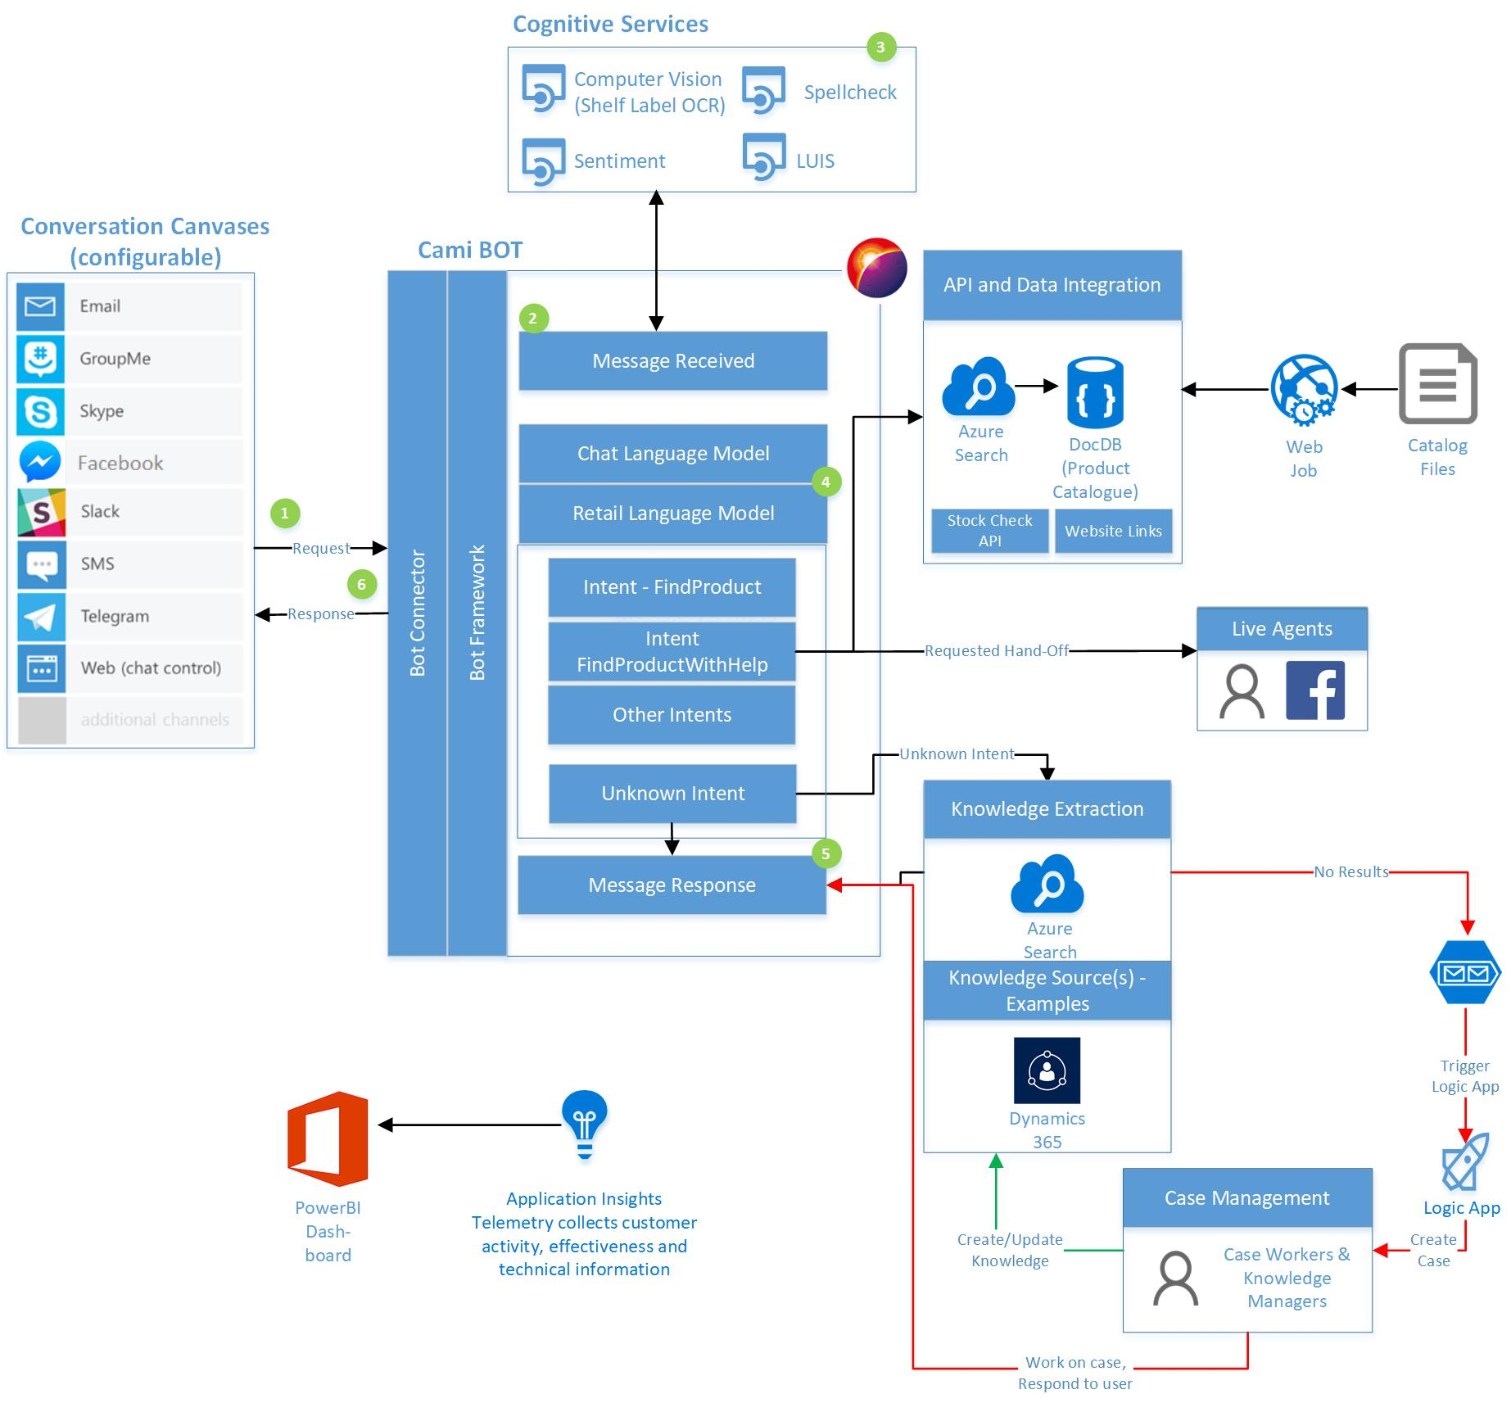
Dixons Carphone
A bot that interacts with customers online
Integrate with “wish list” feature & hand off to humans when needed
Seamless online and in-store experience

Slide 12
Adding NL to Bots using LUIS

Slide 13
Language Understanding
“Find me a wireless mouse at $30”
Identify INTENT : {findItem, buyItem, addToCart, …}
Identify ENTITIES :
Product: wireless mouse
Price {
Value:30
Currency: USD
}

Slide 14




Language Understanding (LUIS) Machine learning-based service to build natural language into apps, bots, and IoT devices. Quickly create enterprise-ready, custom models that continuously improve.
Add natural language to your apps
Quickly build a custom language solution
Always learning & improving
Enterprise-ready, available worldwide
Leverages customizable pre-built apps and entity dictionaries, (e.g. Calendar, Music, Devices).
Dictionaries are mined from the collective knowledge of the web and supply billions of entries, helping your model to correctly identify valuable information from user conversations.
LUIS integrates seamlessly with the Azure Bot Service, making it easy to create a sophisticated bot.
Designed to identify valuable information in conversations, LUIS interprets user goals (intents) and distills valuable information from sentences (entities), for a high quality, nuanced language model.
Custom Models can be created based on the same technology in Azure Machine Learning
The service is ready to be deployed in commercial applications and can scale with enterprise quality and performance.
The service meets international compliance standards, supports 12 languages and available worldwide, making it highly accessible around the world
Active learning is used to continuously improve the quality of the natural language models.
Once the model starts processing input, LUIS begins active learning, allowing you to constantly update and improve the model.

Slide 15
What is New in LUIS for BUILD?

Slide 16
NEW Features
Integrated Experience
Core Language Understanding
Speech. Speech priming now happens automatically when the LUIS app is published. A single key works for LUIS & Speech.
Sentiment. Sentiment analysis, commonly known as Text Analytics Cognitive Service, is now included as part of LUIS. This is included at no additional charge.
Multi-lingual. Build your LUIS application in one language, and Machine Translation is used enable the Bot to work with multiple languages
Patterns. Patterns are templates that teach LUIS common utterances with fewer examples. It is fully integrated with machine learning
Regex entity. Identifies an entity in the utterance based on a regular expression
Key phrase entity. Identifies noun phrases in the utterance using the Cognitive Services Text Analytics APIs
Enterprise-grade Service
General Availability. GA Since December 2017, with SLAs, multiple pricing tiers.
Compliance. GDPR, ISO & HIPAA compliance
Worldwide Support. 12 languages & 13 Azure regions

Slide 17
Demo
Ahmed Ashour

Slide 18
Scenario
Contoso is an online retailer with a customer-obsessed culture
Feedback is received across multiple channels
Shoppers should be able to inquire about products and provide feedback

Slide 19








Solution Overview
Functional Scope
Shopping
Support
Feedback
Social Media Feedback Monitoring & Response
Language Understanding
Language Translation
Sentiment Analysis
Speech Recognition
Spell Check
Bot servicing product queries and feedback
Feedback Analytics
INTELLIGENT CORE
Speech enabled Intelligent desktop app for order tracking

Slide 20
Technical Stack
Bot Framework
Azure Table
Azure App Service
LUIS
QnA Maker
Bing Custom Search
Cognitive Services
Bing Spell Check
Sentiment Analysis
Language Translation
Power BI
Application Insights
Platform Services
Azure SQL

Slide 21
LUIS Schema
Please add pizza cheese to my cart.
Can you add tide laundry powder to my cart?
Add to cart
Add to cart
Buy Item
Buy Item
I am looking for a red jacket for men.
Can you find a wireless mouse for me?
Bing Custom Search
Shopping
Find Item
Find Item
Where is my order 456378?
Can you please track my order 783275832?
Speech Integration
Track Order
Support
Track Order
Connect with Human
This is not helping.
Can you connect me to a customer service agent?
Connect with Human
Policy / Rules
Feedback
Policy / Rules
What is the return policy?
How many days does it take to get my refund?
QnA Maker
Search & Browse
Search & Browse
Ordering
Top Level Intents
Ordering
I've received my phone with broken packaging.
Thanks for the timely delivery of my laptop.
Sentiment Analytics
Shipping & Delivery
Shipping & Delivery
Returns & Refunds
I have not received my refund even after 10 days. Can you please look into it?
I requested to return my broken toy, but no one has come to pick it up.
Child Level Intents

Slide 22
A Deeper Look at LUIS

Slide 23
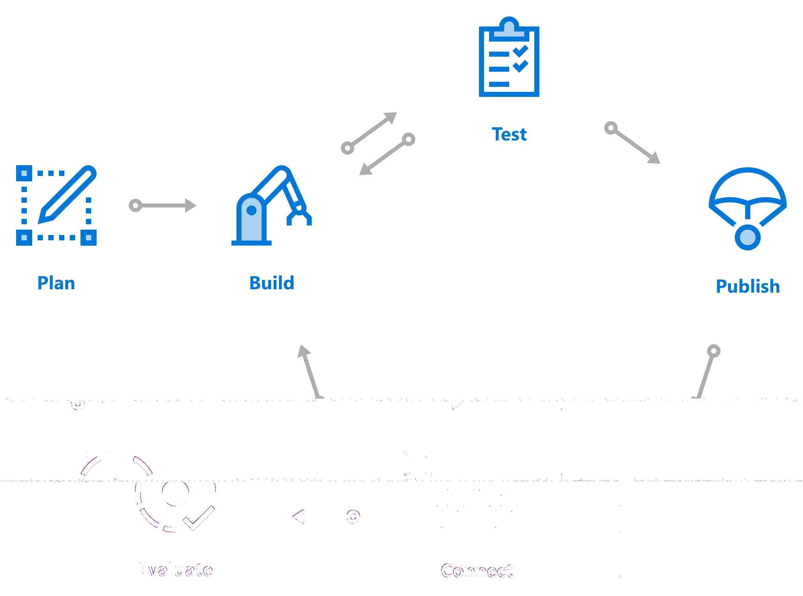
Development Lifecycle: LUIS
An iterative approach using Active Learning
Define Schema
Add training examples
Add features
Test
Publish
< repeat >
Active Learning

Slide 24
Build Models with Less Effort
Active learning focuses labeling where it matters
Prebuilt entities (DateTime, Numbers, Units, Geography, Email, …)
Custom prebuilt domains (Calendar, Music, Weather, Communication, …)
Semantic Dictionaries allow dynamically expanding any list (e.g. 120 Rolling Stone songs, or fruits, or companies, etc.)

Slide 25
Machine Teaching
LUIS is taking the machine teaching approach
Machine Teaching ≠ Machine Learning
"Machine Teaching" is about helping teachers transfer knowledge to machine learning algorithms
"Machine Teaching" is about creating useful models form this knowledge.
There is large community working on this.
The two fields complement each other

Slide 26
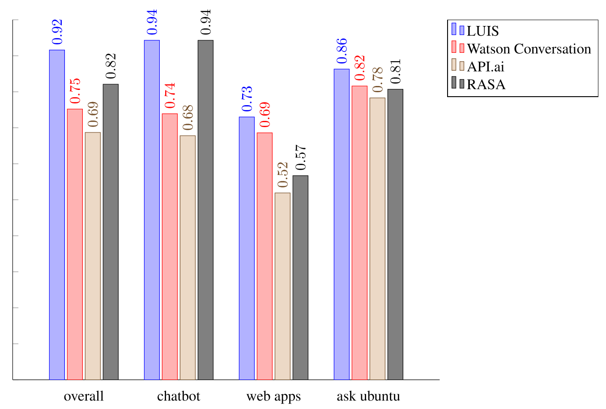
AI Quality Scorecard
SIGDIAL paper comparing LUIS to API.AI and IBM Watson from research team at TUM
“LUIS always performs best, independent from the domain, API.ai always worst, also independent from the domain, merely the second and third place changes.”
LUIS and Watson are close in intent performance while LUIS is much better in entity detection

Slide 27
LUIS Best Practices

Slide 28
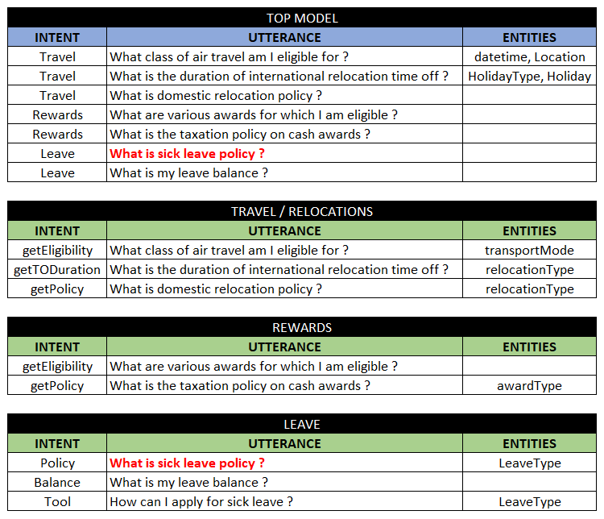
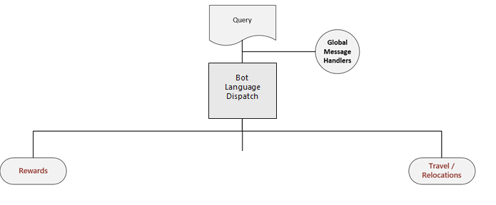

Reference Architecture
“What is sick leave policy”
Rewards
Leave
Travel/
Relocations

Slide 29
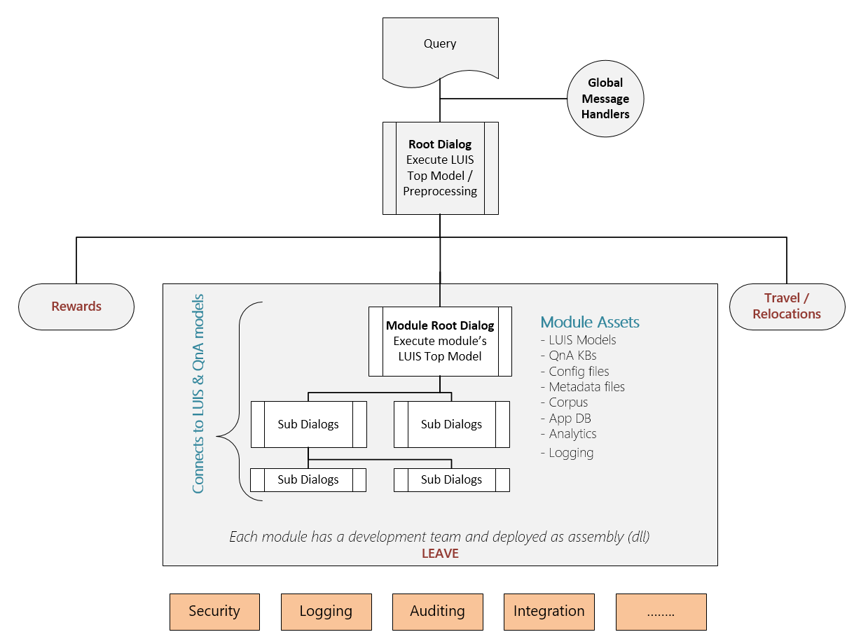
Reference Architecture
“What is sick leave policy”
Bot Language Dispatch

Slide 30
DOs
DON’Ts
Define discriminative intents
Find a sweet spot between too generic & too specific
Build your app iteratively
Add phrase lists & patterns in later iterations
Add examples to NONE (proportional to other intents)
Leverage the suggest feature
Monitor the performance of your app
Add plenty of labels
Use LUIS as a training platform
Add many examples of the same format ignoring other formats
Mix the definition of intents & entities
Create phrase lists with all the possible values
Add so many patterns
Train & publish with every single example

Slide 31
Learn More
AI Labs
Conversation Learner – aka.ms/TBD
Personality Chat – aka.ms/TBD
Get started today –aka.ms/LUIS

Slide 32
Conversational AI Sessions
Breakout
Schedule | Title | Speaker
Tue May 8 3:00-4:15pm | Bot intelligence, Speech Capabilities, and NLU best practices | Riham Mansour; Ahmed Ashour
Wed May 9 8:30-9:45am | Conversational AI: What's New? | Chris Mullins, Darren Jefford
Wed May 9 2:45-4:00pm | Conversational AI: Best Practices for Building Bots | Elaine Chang, Vishwac Sena Kannan
Theater
Schedule | Title | Speaker
Mon May 7 1:00-1:20pm | Cognitive Services Labs in action – Project Personality Chat | Tulasi Menon
Mon May 7 3:00-3:20pm | Cognitive Services Labs in action – Project Conversation Learner | Jason Williams
Mon May 7 4:00-4:20pm | Conversational AI: Bot Building Tools | Carlos Castro, Justin Wilaby
Mon May 7 5:30-5:50pm | Bot Authentication in Conversational AI | Jeff Derstadt
Mon May 7 8:00-8:20pm | Language Understanding Updates | Youssef Shahin
Tue May 8 11-11:20am | QnA Maker: FAQ to Bot in minutes | Prashant Choudhari

Slide 33
Questions & Answers

Slide 34
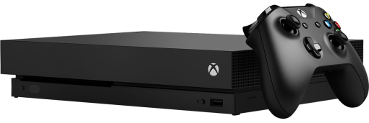
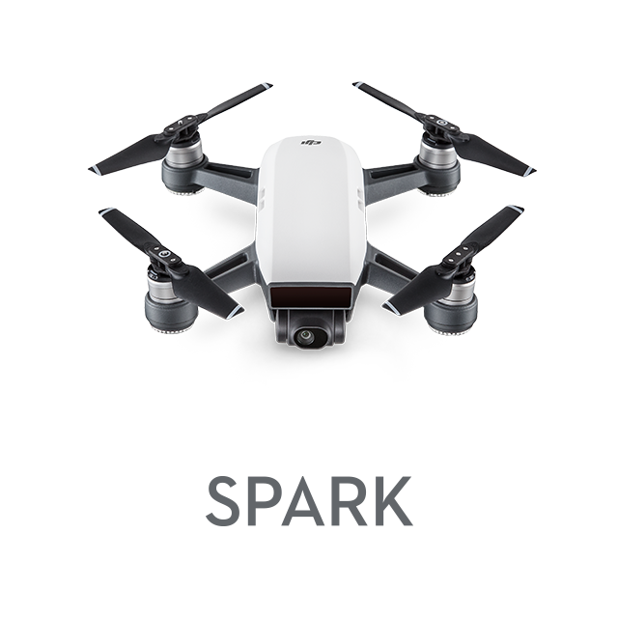

Daily Prizes
Xbox One X
DJI Spark Drone
Starbucks gift cards
Complete your evaluations to win prizes!
Be eligible to win! Make sure you are scanned into your session and complete your session eval to be eligible to win.
Seven winners each day! Winners will be notified via email.
Pick up your prize before leaving!
Prizes can be claimed at the info counter located on WSCC level 4, Galleria level.
Monday: pick up 2:15pm–6:30pm.
Tuesday: pick up 7:00am–6:00pm.
Wednesday: pick up 7:00am–5:30pm.
Please contact build@eventcore.com for more information

Slide 35
Appendix

Slide 36
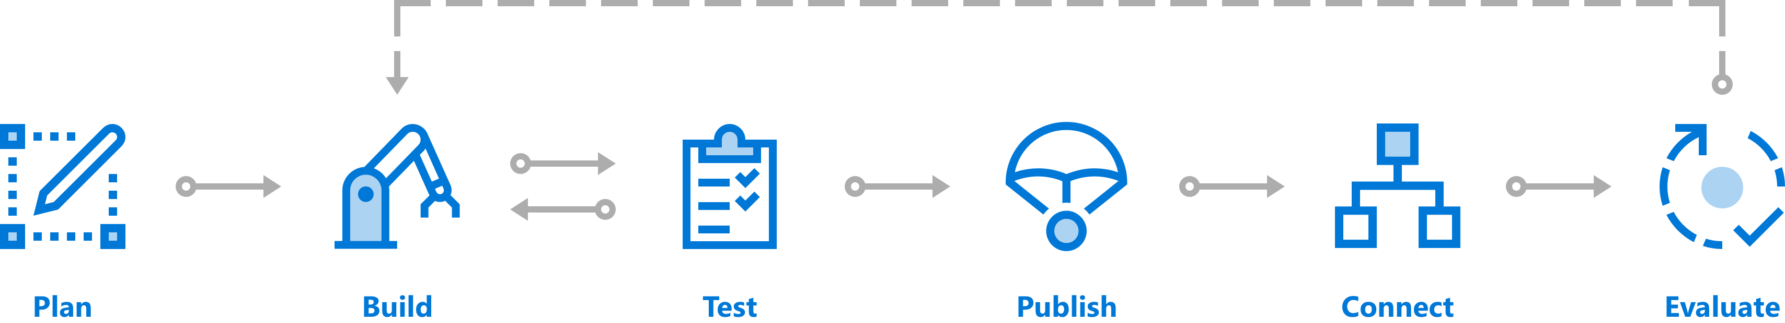
Create a Conversation with Bot Service
Comprehensive framework for the lifecycle of your project
Plan
Build
Test
Publish
Connect
Evaluate

